Slide 1














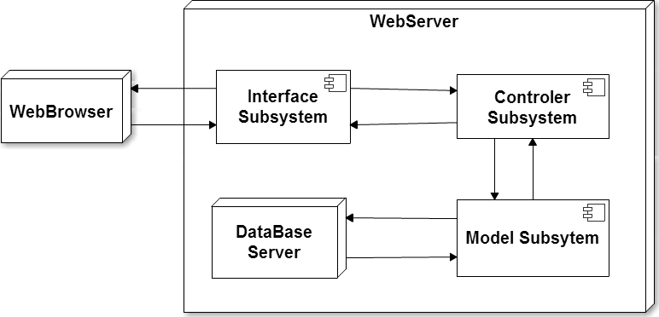
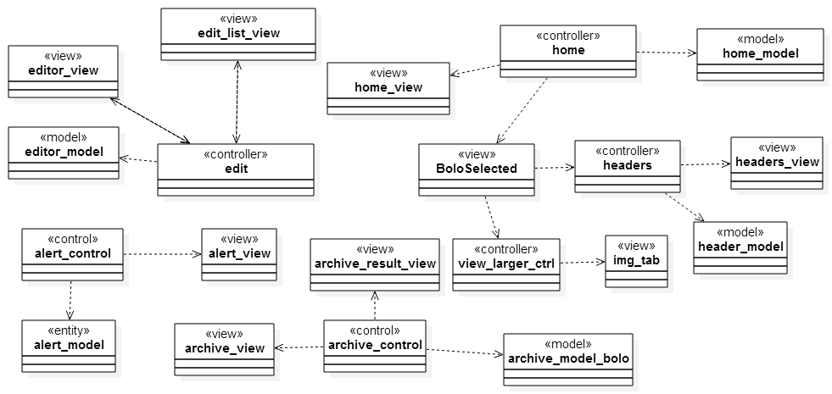
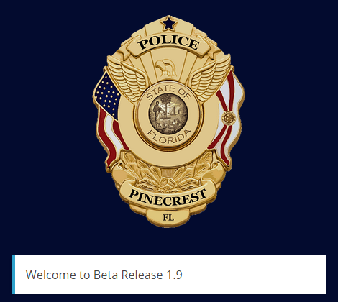
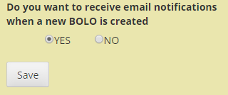
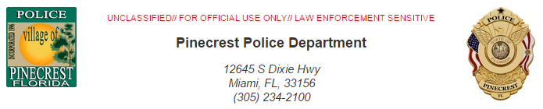
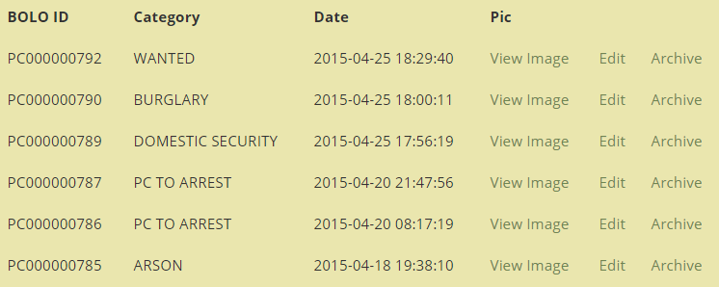
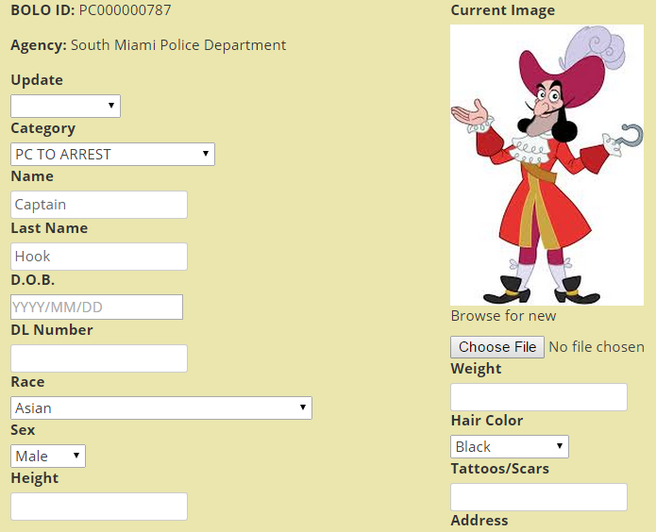
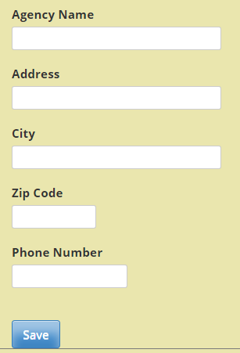
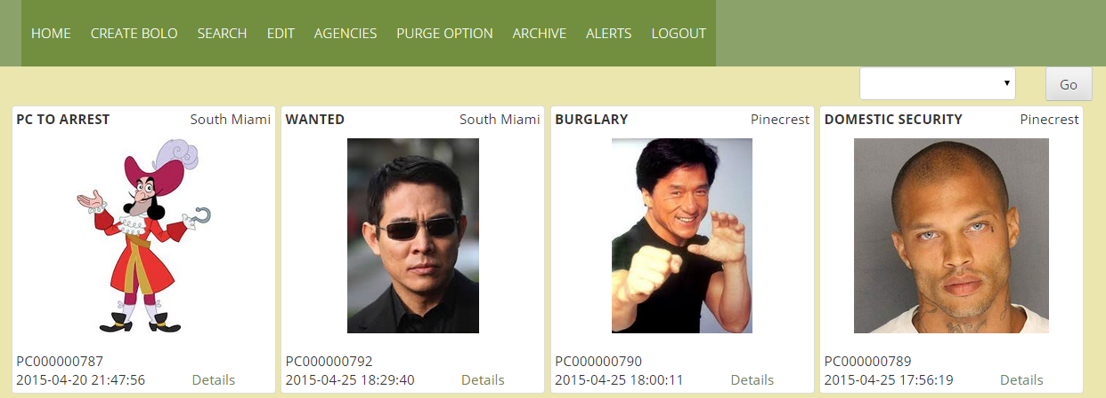
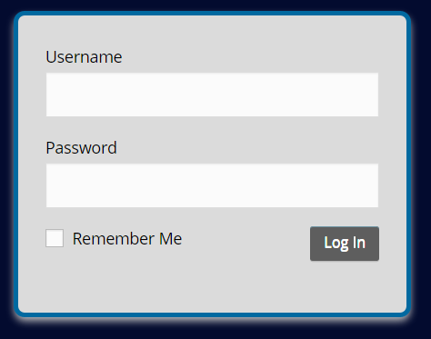

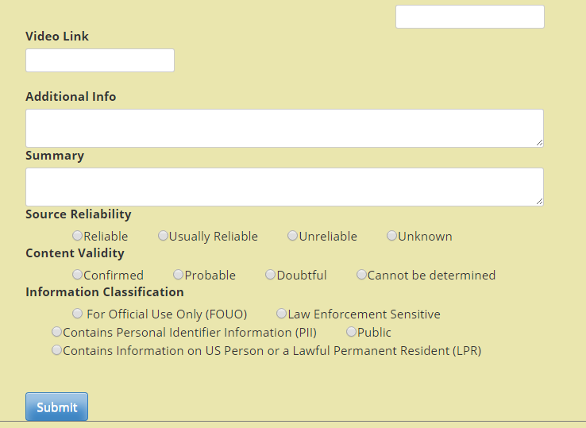
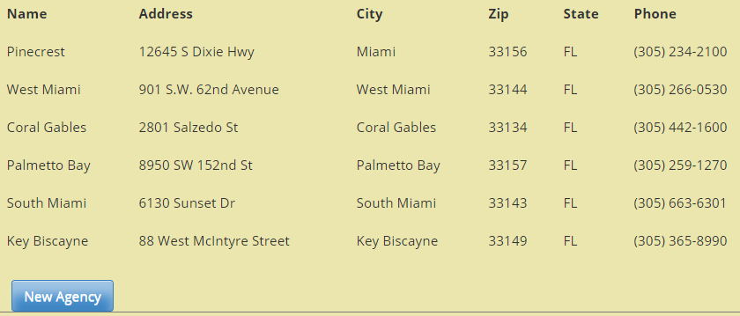
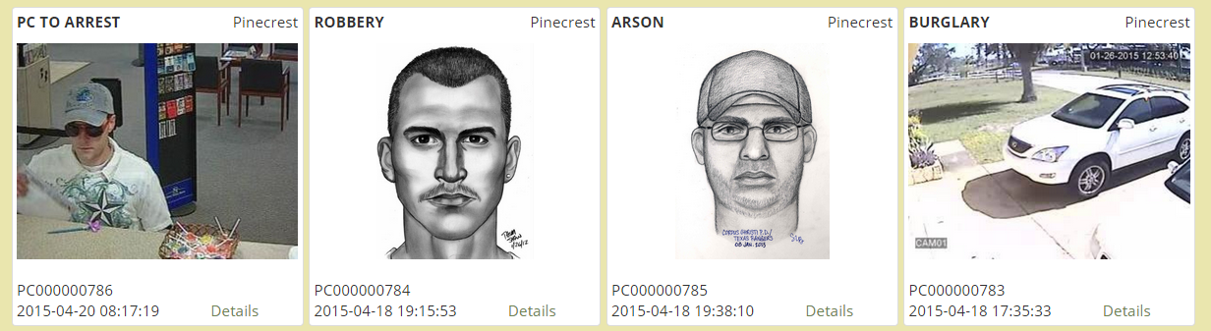
School of Computing & Information Sciences
Senior Project, 2015, Spring
BOLO Flier Creator
Student: Icxe Vidal, Florida International University
Mentor: Major Jason Cohen, Pinecrest Police Department
Instructor: Masoud Sadjadi, Florida International University
Problem
Current System
Requirements
BOLOS, or Be On the Look Outs, is a law enforcement term that describes the way information is shared amongst police officers and between police agencies.
First responding police officer does not usually have the capability or time to create such flyer. Flyers are commonly created by detectives or analysts several days after the incident was reported. The distribution is via email so there is no central, searchable database. If you are not on the email distribution list, you don’t get the BOLO flyer.
A BOLO is distributed in several ways:
Over the police radio: When an incident occurs the responding officer will “BOLO” pertinent information over the police radio for other units to hear.
Via Computer Aided Dispatch (CAD) message: The officer will send a text only message via the CAD to other police units that are currently on duty.
A BOLO Flyer (Document) with pertinent information, to include pictures, is created, usually via MS WORD and then converted to PDF and distributed to other officers or agencies via Email or FAX.
BOLO Flyer Creator was designed to streamline this process and give the first responding officers the ability to quickly, from the field, create a BOLO flyer and distribute it via email and pdf to all users.
This can be done at the time the crime is reported.
This application not only distributes the flyer but posts it to a central site that is searchable.
All users have the ability to see via a graphical interface, all BOLOs posted as well as search the BOLOs by a variety of different criteria. BOLO flyer creator also give the user the ability to attach a video link should the video of the incident be available.
This solution allows all registered users, regardless of whether they were on duty or not the ability to view the flyers.
Using this application information is shared in as close to real time as possible as well as preserved via database for use and review at any time.
System Design
Implementation
The system implements uses a Server-Client architecture, with all the implementation being found within server side, where an Model-View-Controller architecture is used
The front end of the website was implemented using HTML and JavaScript; and Bootstrap to make it mobile friendly, while PHP was used in the back end.
MySQL was selected as our Database Management System.
In order to create the pdf version of the BOLO we used the open source library mPDF
Verification
Test Case ID | Bolo-004-Edit_SUNNY_1
Purpose | To validate use case Bolo-004 Edit by editing an existing BOLO
Preconditions | The user has logged into the system The user has clicked on the edit link in the navigation bar
Input(s) | click on BOLO of ID: PC0000787 enter new height = “5, 11” user clicks on Save
Expected Result | The current state of BOLO PC0000787 has been saved in the database BOLO number PC0000787 has been updated with a new height = “5, 11”
Result | PASS
Object Design
Summary
After months of work we were able to implement system that met all the requirements our product owners requested.
This website provides first responder officers with a simple tool to create and distribute BOLOs from either a PC or their mobile device at the same time a crime is reported.
It effectively streamlines a process that could take days to a matter of seconds
Test Case ID | Bolo-023-Opt out Notifications_SUNNY_1
Purpose | To validate use case Bolo-023-Opt out of Notifications
Preconditions | The user currently receives email notifications when new BOLOs are created The user has logged into the system The user has navigated to the Alerts screen
Input(s) | User clicks on “No” User clicks on “Save” User creates a new BOLO
Expected Result | The user doesn’t receive an email notification after the BOLO is created
Result | PASS
Screenshots
Acknowledgement
The material presented in this poster is based upon the work supported by Major Jason Cohen and the Pinecrest Police Department. I am thankful to the help that I received from my group member, Danae I. Perez Tillan.

